Slide 1
BCS 370 Data Structures
Arthur Hoskey, Ph.D.
Farmingdale State College
Computer Systems Department

Slide 2
Today’s Lecture
Chapter 8 ADT Binary Search Trees (continued)
Created By Arthur Hoskey, PhD

Slide 3
Goals
Define and use the following terminology: binary tree root descendant subtree binary search tree
parent level ancestor
child height
Define a binary search tree at the logical level
Show what a binary search tree would look like after a series of insertions and deletions

Slide 4
Goals
Implement the following binary search tree algorithms in C++
    Inserting an element
    Deleting an element
    Retrieving an element
    Modifying an element
    Copying a tree
    Traversing a tree in preorder, inorder, postorder

Slide 5
Goals
Discuss the Big-O efficiency of a given binary search tree operation
Describe an algorithm for balancing a binary search tree
Show how a binary tree can be represented in an array, with implicit positional links between the elements
Define the terms full binary tree and complete binary tree

Slide 6
Recursive Deletion
Can you summarize the three deletion cases?
Created By Arthur Hoskey, PhD

Slide 7
Recursive Deletion
Three Deletion Cases
Leaf – Delete node is a leaf. Delete the node and set the child pointer of parent to null.
One child – Delete node has one child. Delete the node and fix the child pointer of the parent to point to the appropriate child of the node to be deleted.
Two children – Delete node has two children. Copy the data from the predecessor into the node to be deleted. The predecessor is the largest value in the left subtree of the node to be deleted. Finally, delete the predessor node.
Created By Arthur Hoskey, PhD

Slide 8
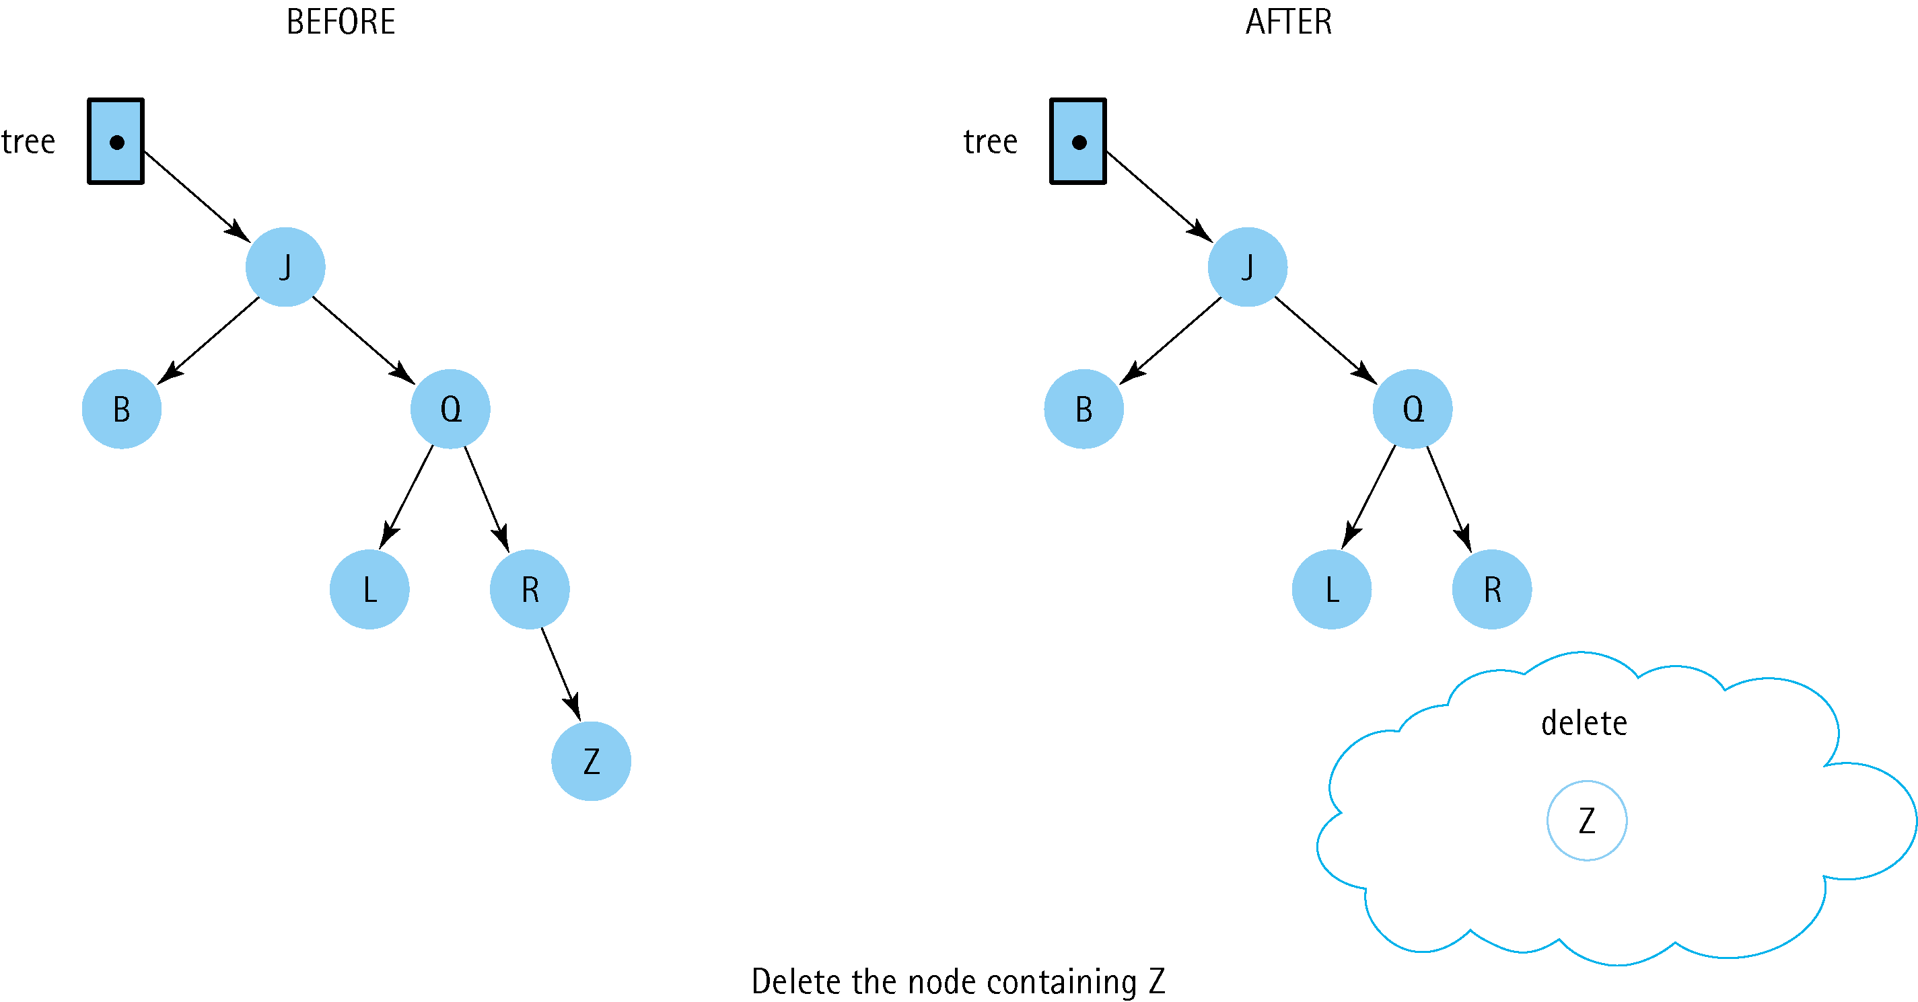
Recursive Deletion
Delete ‘Z’

Slide 9
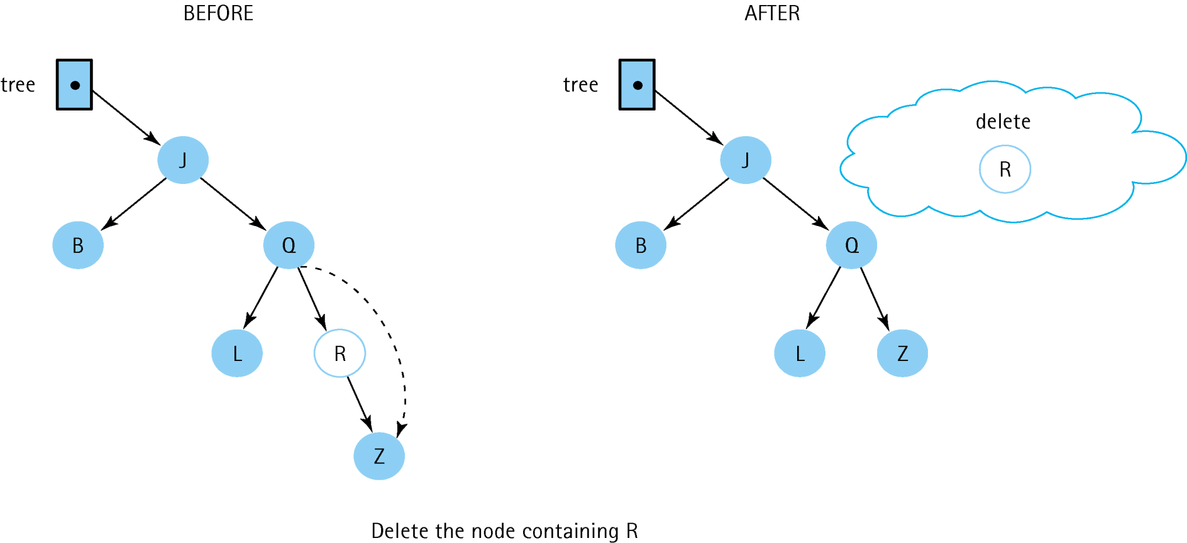
Recursive Deletion
Delete ‘R’

Slide 10
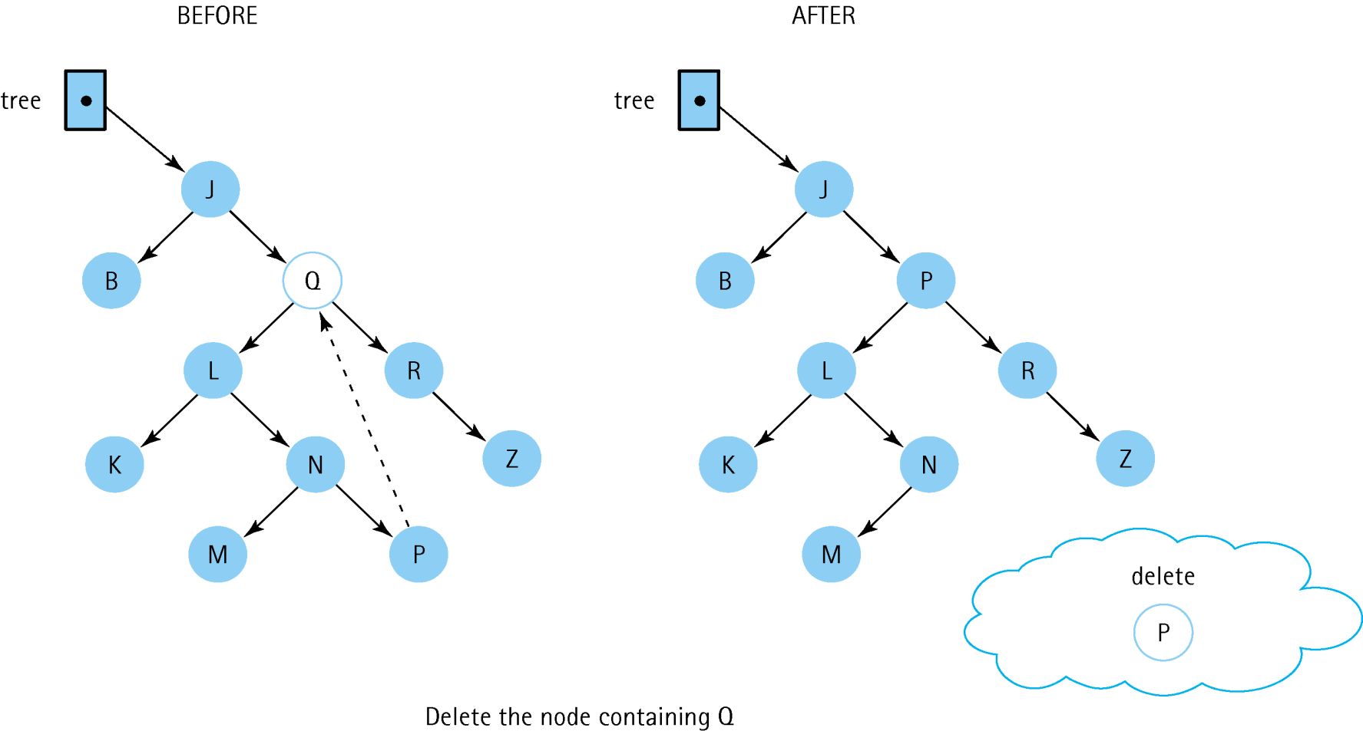
Recursive Deletion
Delete ‘Q’
What is going on here???
Will explain soon.

Slide 11
Recursive Deletion
Delete ‘Q’
P is the pred of Q.
Search property is preserved

Slide 12
Printing, Clearing and Traversing
Next will cover…
Printing the tree
Clearing the tree
Traversing the tree

Slide 13
Printing The Tree
Print the data from the tree in key order.
Use a recursive algorithm.
Created By Arthur Hoskey, PhD

Slide 14
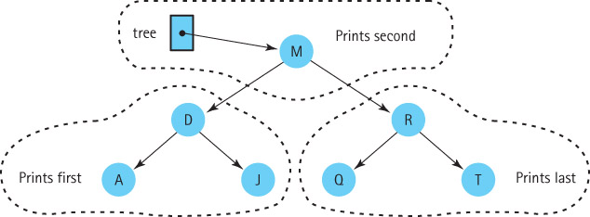
Printing The Tree
Apply same algorithm to each tree
What is the order of the output?

Slide 15
Printing The Tree
void PrintTree(TreeNode* tree, ostream& out)
{
if (tree != NULL)
{
PrintTree(tree->left, outFile);
out << tree->info;
PrintTree(tree->right, outFile);
}
}
Print the left subtree
Print the current node
Print the right subtree

Slide 16
Printing The Tree
How do we clear the tree?
Here is MakeEmpty()…
Created By Arthur Hoskey, PhD

Slide 17
Clearing The Tree
void TreeType::MakeEmpty() {
MakeEmpty(root);
root = null;
}
void TreeType::MakeEmpty(Node*& tree)
{
if (tree != NULL)
{
MakeEmpty(tree->left);
MakeEmpty(tree->right);
delete tree;
}
}
Clear the left subtree
Clear the right subtree
Delete the current node

Slide 18
Clearing The Tree
void TreeType::~TreeType () {
MakeEmpty();
}
Destructor can just call MakeEmpty

Slide 19
Copying a Tree
CopyTree(copy, originalTree)
if (originalTree is NULL)
Set copy to NULL
else
Set copy to new node
Set Info(copy) to Info(originalTree)
CopyTree(Left(copy), Left(originalTree))
CopyTree(Right(copy), Right(originalTree))
How must copy be passed?
How must originalTree be passed?

Slide 20
Copying A Tree
void TreeType::CopyTree(TreeNode*& copy,
const TreeNode* originalTree)
{
if (originalTree == NULL)
copy = NULL;
else
{
copy = new TreeNode;
copy->info = originalTree->info;
CopyTree(copy->left, originalTree->left);
CopyTree(copy->right, originalTree->right);
}
}
Copy the current node
Copy the left subtree
Copy the right subtree

Slide 21
Traversals
Traversal
Visit all nodes of the data structure
How do you traverse an unsorted list that uses a linked implementation?

Slide 22
Traversals
Traversal
Visit all nodes of the data structure
How do you traverse an unsorted list that uses a linked implementation?
ANSWER
1. Create a temporary pointer that points to the start of the list.
2. Use that pointer to “visit” each node on the list.
3. Keep going until that pointer is NULL. If the pointer is NULL then you reached the end of the list.

Slide 23
Traversals
Traversal
Visit all nodes of the data structure
How do you traverse a binary search tree that uses a linked implementation?

Slide 24
Traversals
Traversal
Visit all nodes of the data structure
How do you traverse a binary search tree that uses a linked implementation?
ANSWER
There are three common ways to traverse a binary search tree.
1. Inorder
2. Preorder
3. Postorder

Slide 25
Traversals
Will traverse the binary search tree recursively.
Inorder – Process the left subtree (recursively) then “visit” the current node then process the right subtree (recursively)
Preorder – Visit the current node then process the left subtree (recursively) then process the right subtree (recursively).
Postorder – Process the left subtree (recursively) then process the right subtree recursively then “visit” the current node.

Slide 26
Traversals
The pre-, post-, and in- refer to when the current node is processed with respect to the left and right subtrees.
For preorder the current node is processed BEFORE the left and right subtrees.
For postorder the current node is processed AFTER the left and right subtrees.
For inorder the current node is processed AFTER the left subtree but BEFORE the right subtree. Inorder will have the effect of “visiting” each node according to the order of the key of the tree.

Slide 27
Traversals
Inorder(tree)
if tree is not NULL
Inorder(Left(tree))
Visit Info(tree)
Inorder(Right(tree))
PostOrder(tree)
if tree is not NULL
Postorder(Left(tree))
Postorder(Right(tree)
Visit Info(tree)
PreOrder(tree)
if tree is not NULL
Visit Info(tree)
Preorder(Left(tree))
Preorder(Right(tree))
alphabetic order
expression evaluation
destructor (why?)

Slide 28
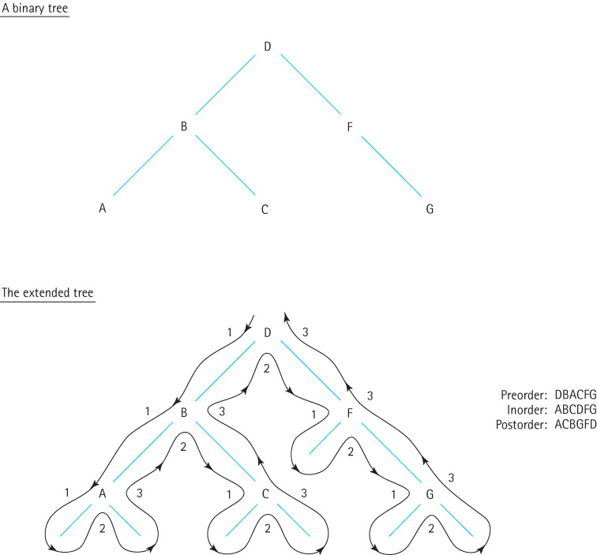
Traversals
Each node
is visited
three times

Slide 29
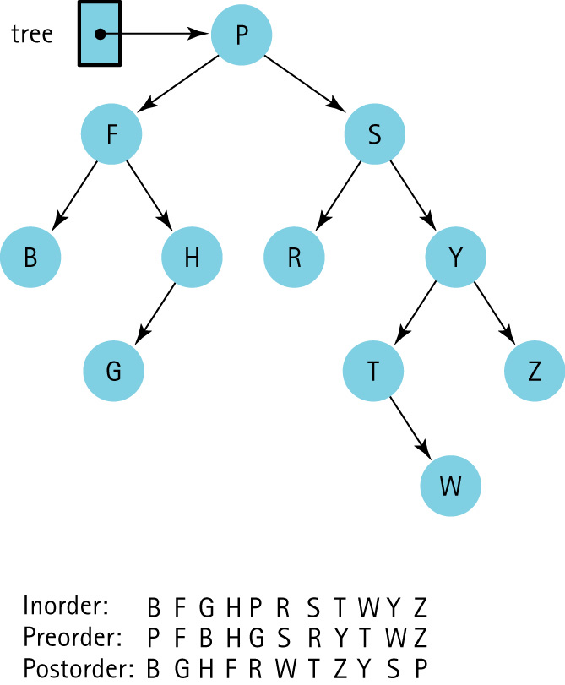
Traversals

Slide 30
Traversals
Show Output
Inorder
Preorder
Postorder
Root
52
21
77
11
33
56
88
Leaf Nodes
Created By Arthur Hoskey, PhD

Slide 31
Traversals
Show Output
Inorder
11, 21, 33, 52, 56, 77, 88
Preorder
52, 21, 11, 33, 77, 56, 88
Postorder
11, 33, 21, 56, 88, 77, 52
Root
52
21
77
11
33
56
88
Leaf Nodes
Created By Arthur Hoskey, PhD

Slide 32
Iterative Versions
There are non-recursive versions of methods used on binary search trees
Here are some non-recursive methods that can be used on a binary search tree.

Slide 33
Iterative Versions
FindNode(tree, item, nodePtr, parentPtr)
Set nodePtr to tree
Set parentPtr to NULL
Set found to false
while more elements to search AND NOT found
if item < Info(nodePtr)
Set parentPtr to nodePtr
Set nodePtr to Left(nodePtr)
else if item > Info(nodePtr)
Set parentPtr to nodePtr
Set nodePtr to Right(nodePtr)
else
Set found to true
Gives you two pointers when done:
1. The node
2. The parent of the node

Slide 34
Iterative Versions
InsertItem
Create a node to contain the new item
Find the insertion place
Attach new node
Find the insertion place
FindNode(tree, item, nodePtr, parentPtr);

Slide 35
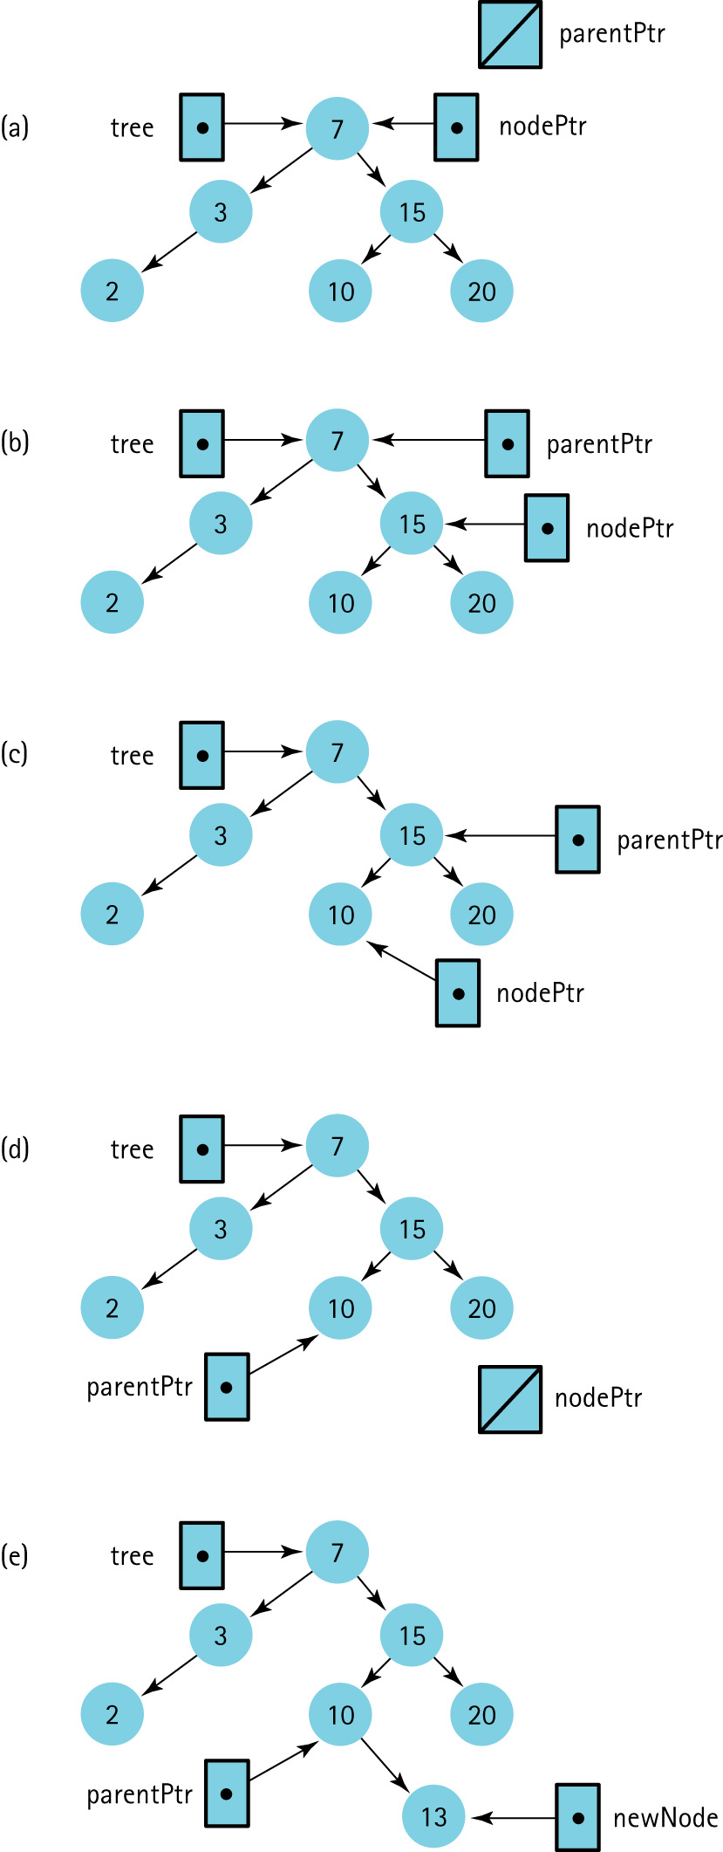
Iterative Versions
Insert 13

Slide 36
Iterative Versions

Slide 37
Iterative Versions
AttachNewNode
if item < Info(parentPtr)
Set Left(parentPtr) to newNode
else
Set Right(parentPtr) to newNode
See a
problem
?

Slide 38
Iterative Version
AttachNewNode(revised)
if parentPtr equals NULL
Set tree to newNode
else if item < Info(parentPtr)
Set Left(parentPtr) to newNode
else
Set Right(parentPtr) to newNode

Slide 39
Iterative Version
void TreeType::DeleteItem(ItemType item)
{
TreeNode* nodePtr;
TreeNode* parentPtr;
FindNode(root, item, nodePtr, parentPtr);
if (nodePtr == root)
DeleteNode(root);
else
if (parentPtr->left == nodePtr)
DeleteNode(parentPtr->left);
else
DeleteNode(parentPtr->right);
}

Slide 40
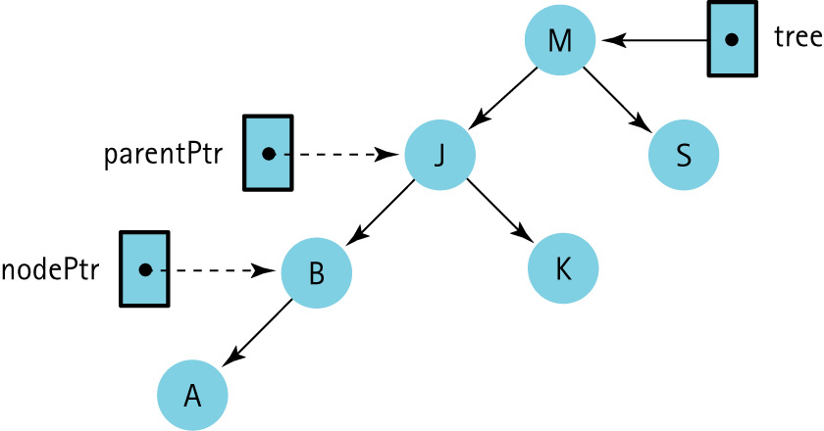
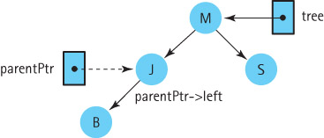
Iterative Version
parentPtr and nodePtr are external; parentPtr->left is internal

Slide 41
Recursion VS Iteration
Compare versions of Tree algorithms
Is the depth of recursion relatively shallow?
Is the recursive solution shorter or cleaner?
Is the recursive version much less efficient?

Slide 42
Attendance
Take attendance now!!!
Created By Arthur Hoskey, PhD

Slide 43
End of Slides
End of Slides
Created By Arthur Hoskey, PhD

